Slide 1
Organizational Impact of RAD

Slide 2
Roundtable Participants
Sunia Zaterman, CLPHA
Sheila Jones, President, Selenium Properties & Board of Commissioners, Charlotte Housing Authority
Shannon Lestan, Managing Director, Recap Real Estate Advisors
Lucie Du, President & CEO, Du & Associates
Cheryl Thomas, VP Asset Management, Columbus MHA

Slide 3
RAD – A Cultural Shift
What does it mean to experience a cultural shift in an organization?

Slide 4
Up Front Planning Decision
Organizational Development
Self Development/ Self Management
Staff Development
Board Development
Portfolio Planning
Capital Needs & Recapitalization Schedule
PBRA vs. PBV
Blending RAD & Section 18—new options
Transfer of Assistance

Slide 5
PBRA vs. PBV
PBV Advantages | PBRA Advantages
Remain under HUD’s Office of Public and Indian Housing (PIH) | Congressional Appropriations viewed as a more stable funding source. HUD has never failed to fully fund or renew a PBRA HAP Contract.
Most PHAs already operate a Housing Choice Voucher Program and many operate a PBV program | Rent cap is the lower of current funding and FMR rent cap – 120% of FMR. This can go up to 150% of FMR if supported with a rent comp study.
Tenant Certifications and Waitlist Management remain with the PHA | Choice Mobility: PHA can request a good cause exemption. Voucher turnover cap for RAD projects can be 1/3 of turnover voucher inventory. Project turnover cap can be limited to 15% of total units a year.
PHA earns a PUPM Administrative Fee | PBRA are renewed under MAHRA following the expiration of the initial contract. While that is 20 years away, MAHRA renewals allow for greater flexibility with respect to future rent increases (such as budget-based and Mark-up-to-Market).

Slide 6
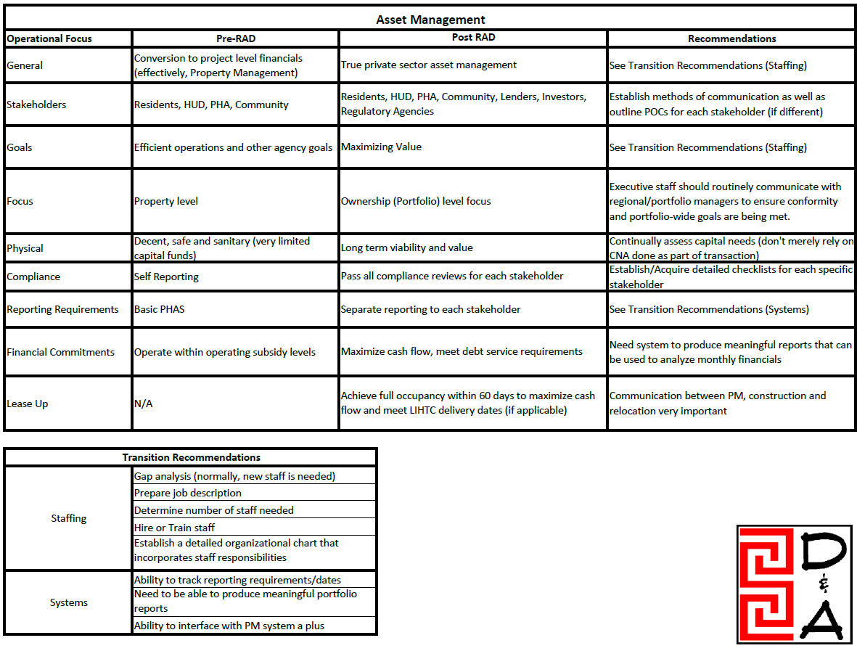
What is Asset Management?

Slide 7
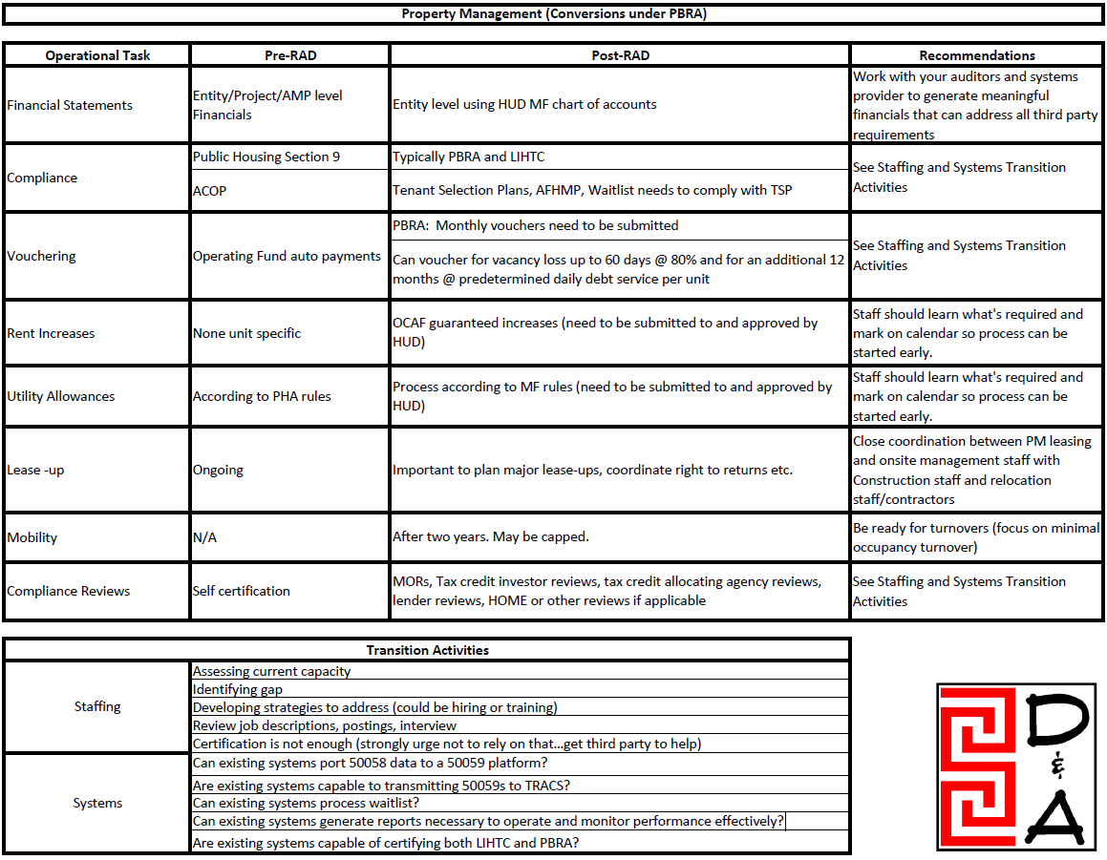

Slide 8
Staffing, Training
Assessing current capacity
Identifying gap
Developing strategies to address the gap
Review job descriptions and compensations plans
Certifications are helpful but is not enough- get third party to help

Slide 9
Business Systems- Software
Can existing systems port 50058 data to a 50059 platform?
Are existing systems capable to transmitting 50059s to TRACS?
Can existing systems process waitlist?
Can existing systems generate reports necessary to operate and monitor performance effectively?
Are existing systems capable of certifying both LIHTC and PBRA?

Slide 10
Other Needed Capacity
Development
PILOT’s
Property Insurance
Guarantees
Reserves
HCV Administrator
Third-Party Partner selection

Slide 11
Residents
Education & Supports
Communications
Relocation
Choice Mobility
ACOP vs No ACOP
Tenant Advocacy groups

