Slide 1
R WELCOME—and Thanks to Our Southeast Regional Convening Local Hosts & Sponsors!

Slide 2
Greensboro Housing Authority

Slide 3
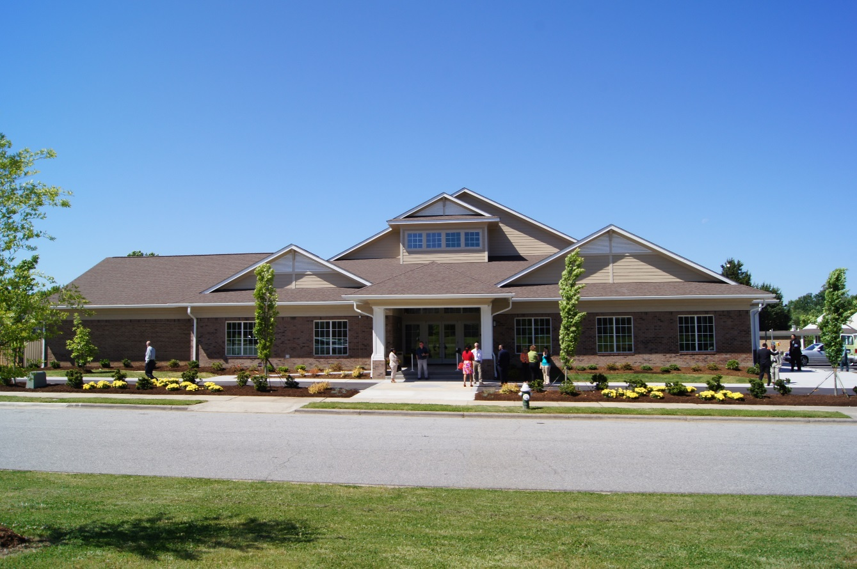
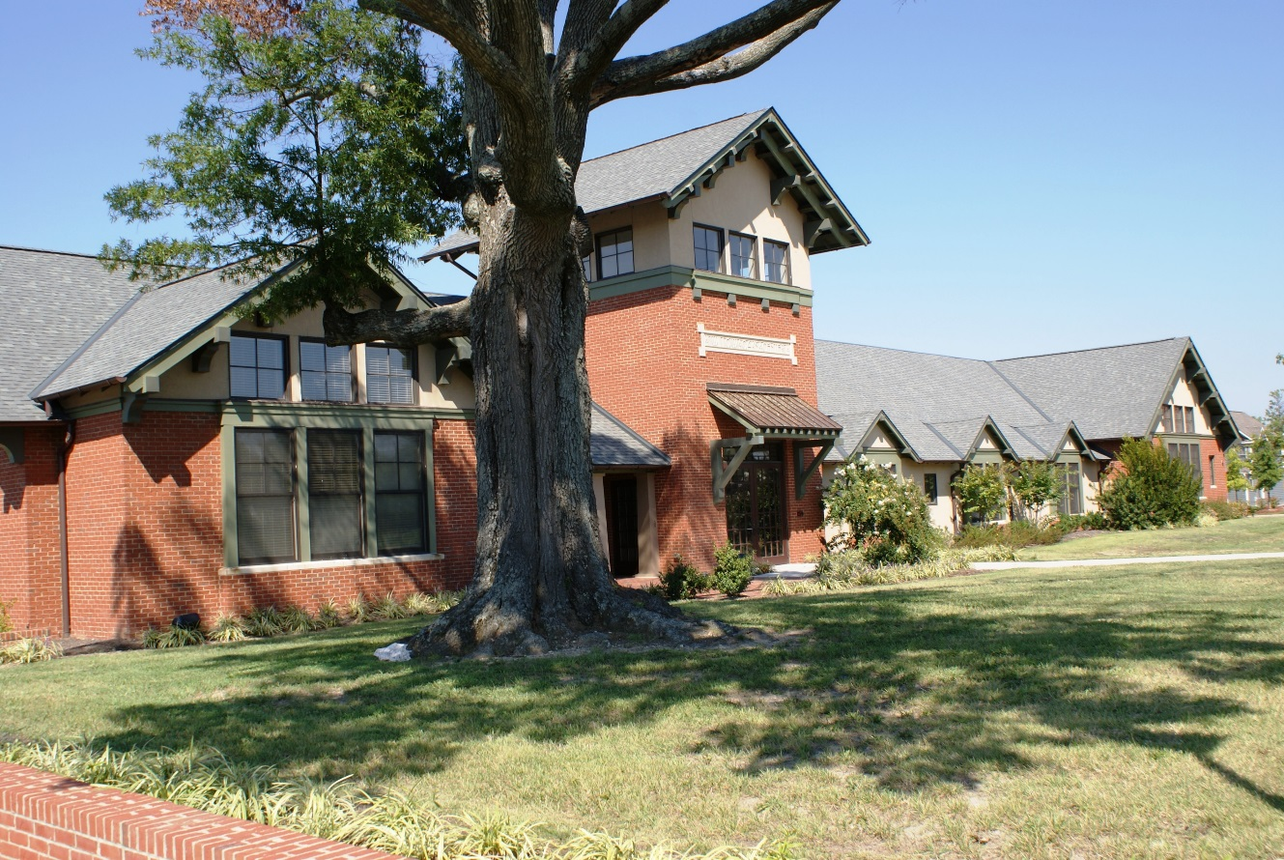
Claremont Community Building
Willow Oaks Community Center

Slide 4
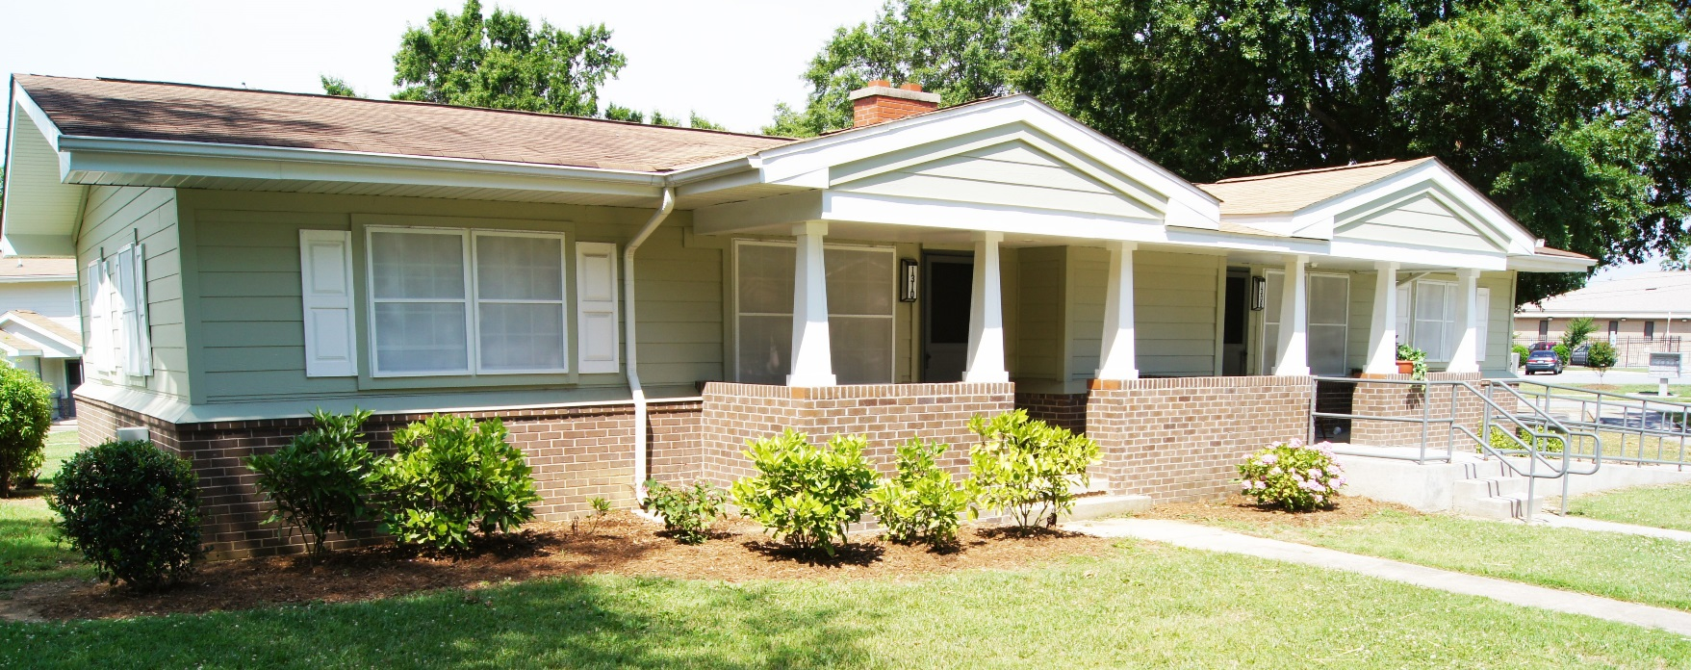
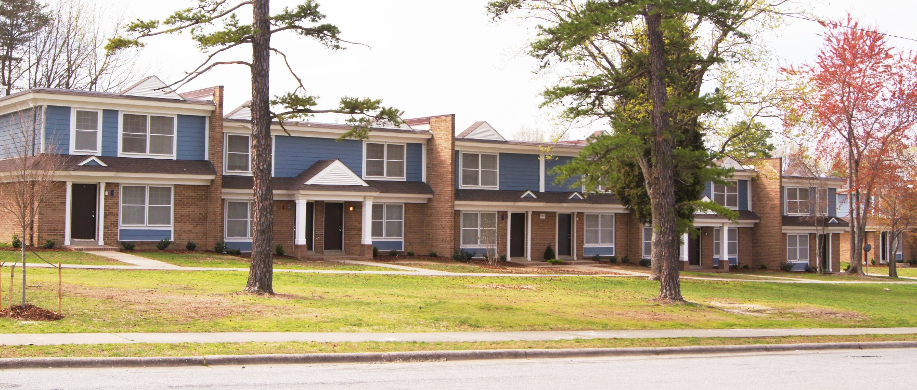
Hampton Homes
Humboldt Gardens
Claremont Courts

Slide 5
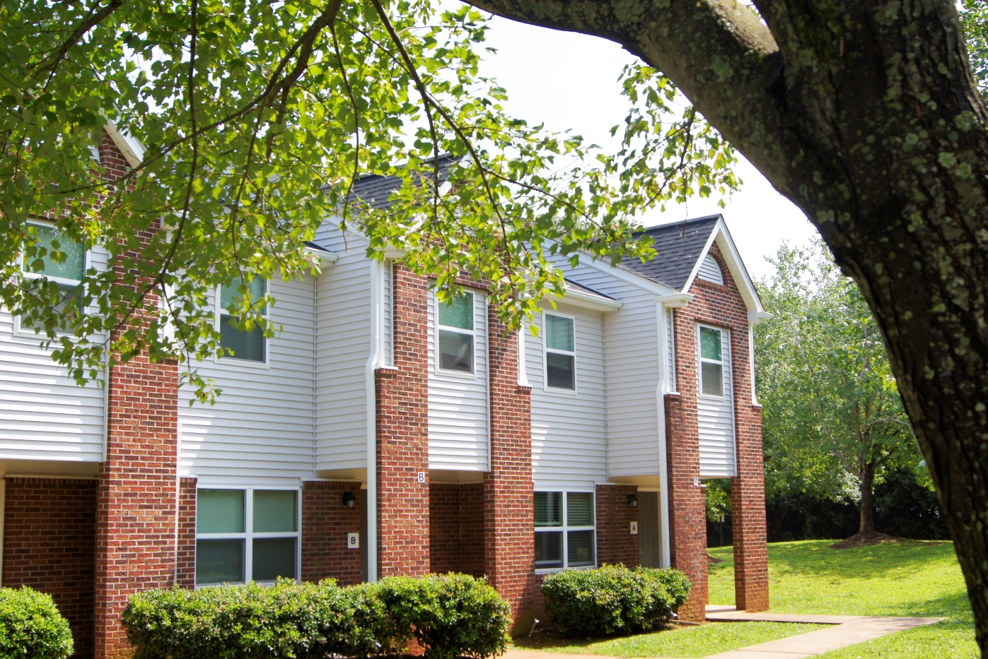
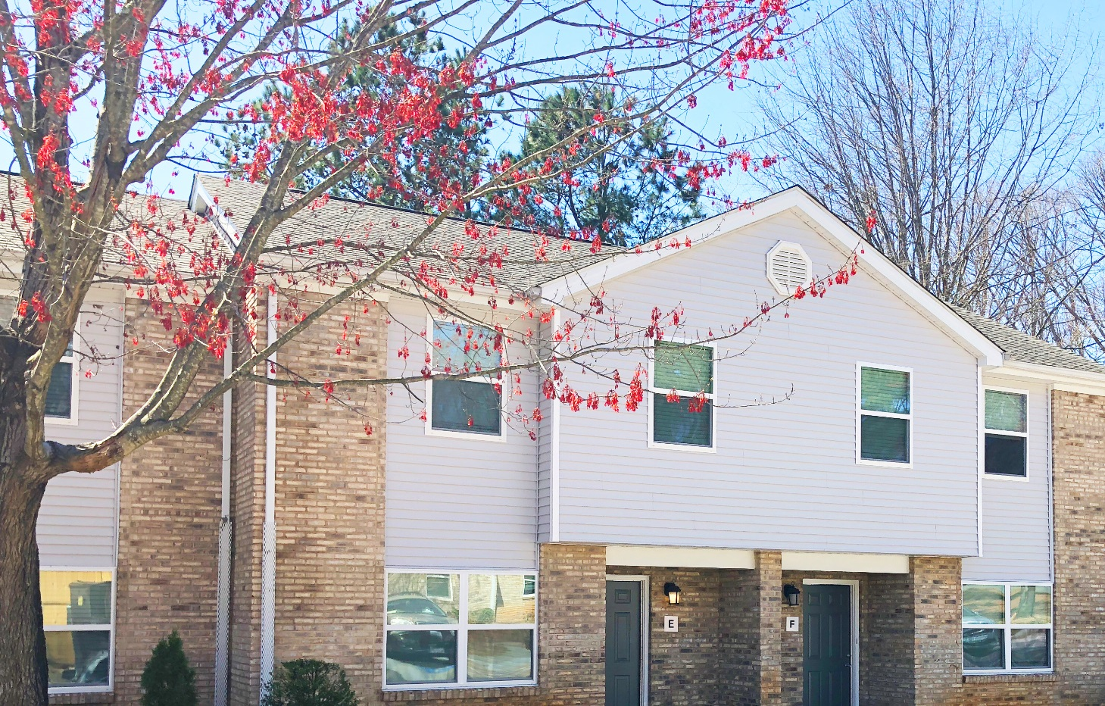
River Birch
Laurel Oaks

Slide 6
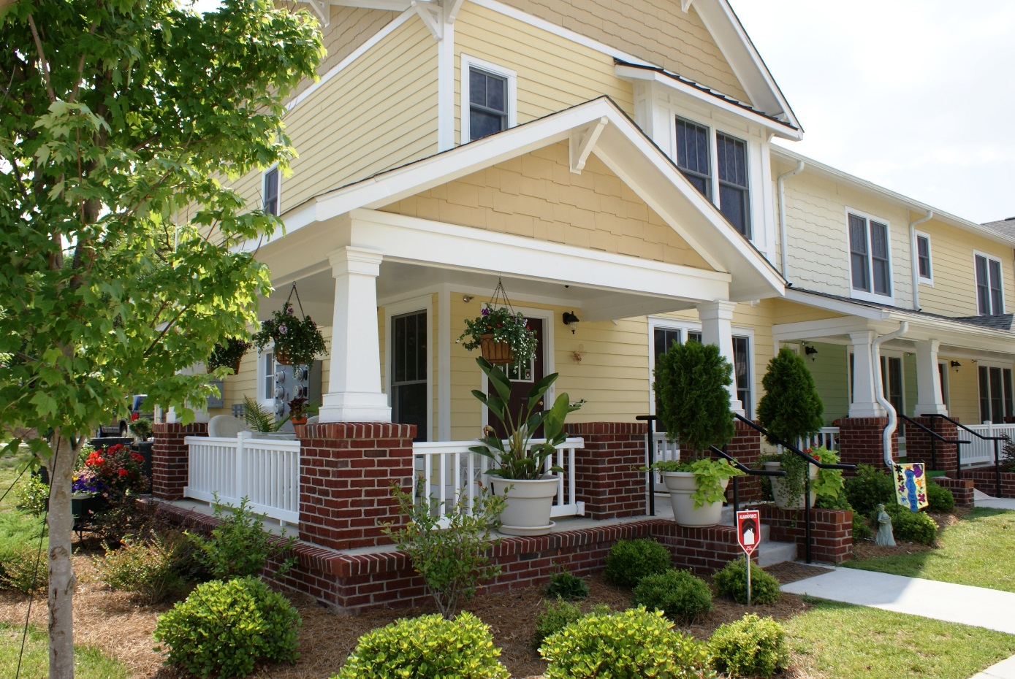
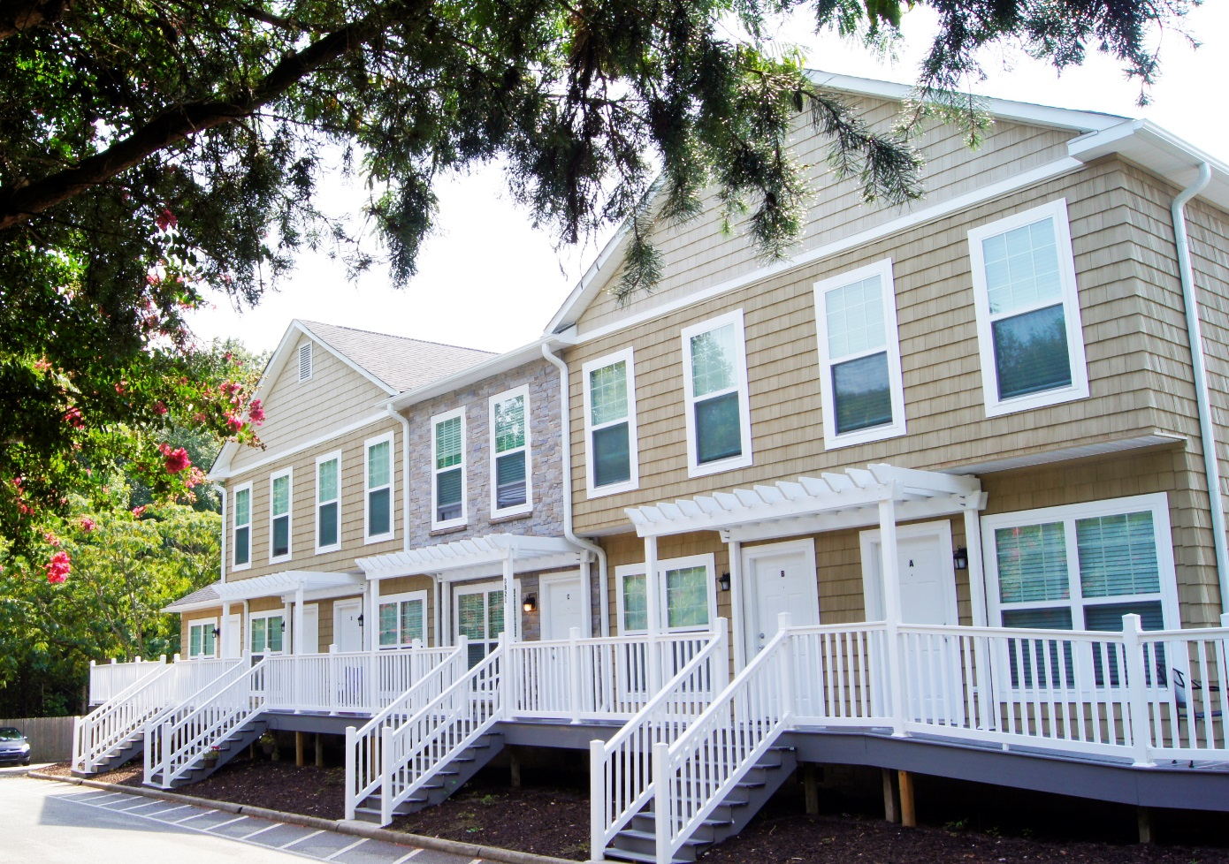
Woodland Village
The Havens

Slide 7
Wilson Housing Authority

Slide 8
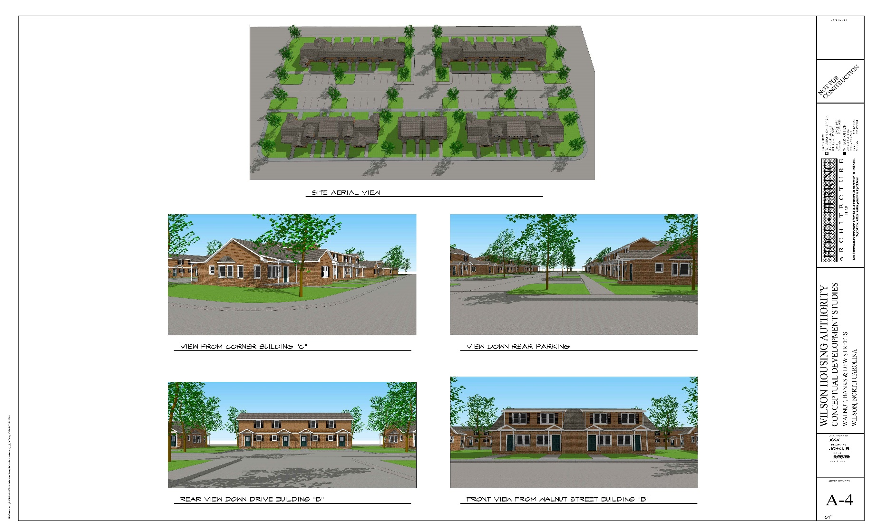
Wilson Housing Authority
New RAD Construction

Slide 9
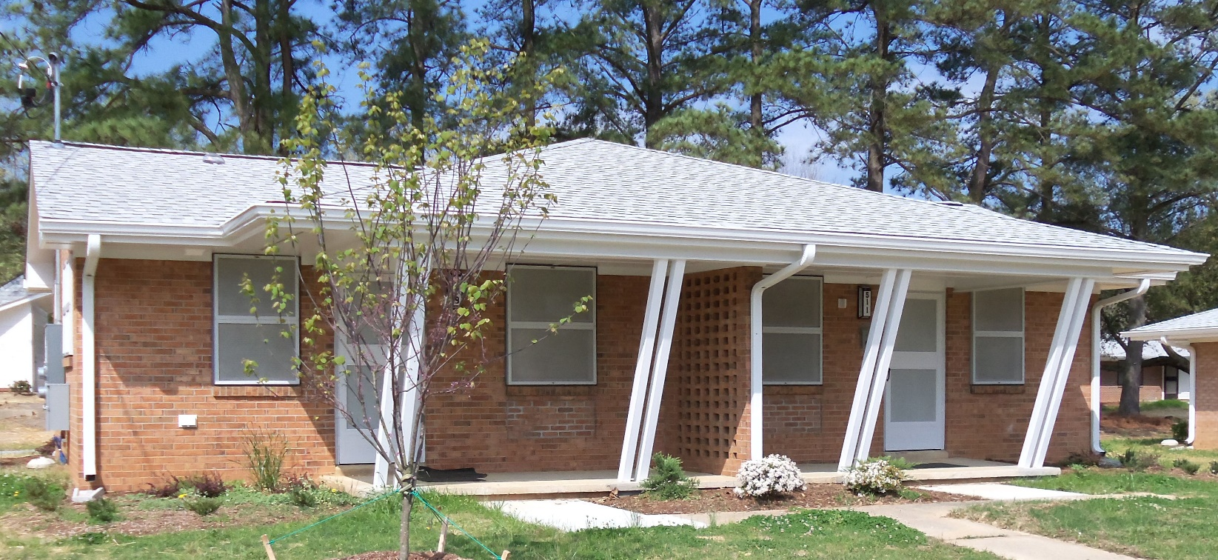
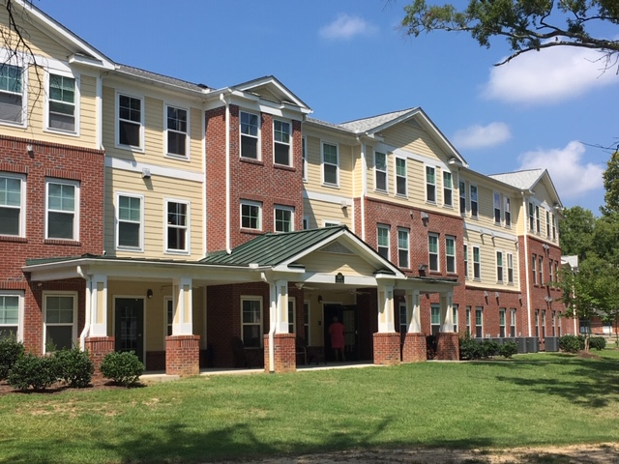
Forrest Green
Forrest Green Senior Building

Slide 10
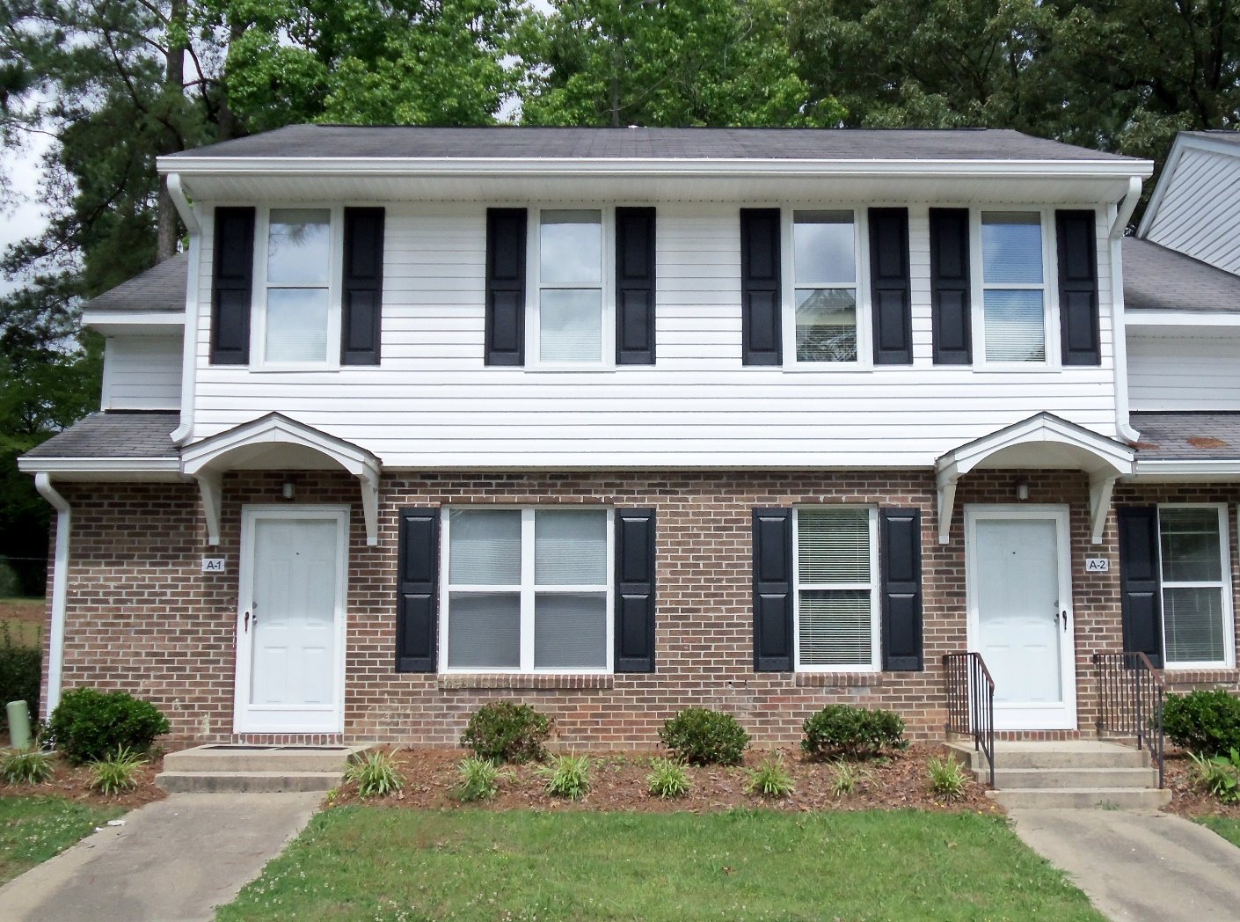
RAD – Transfer of Assistance

Slide 11
Wilmington Housing Authority

Slide 12
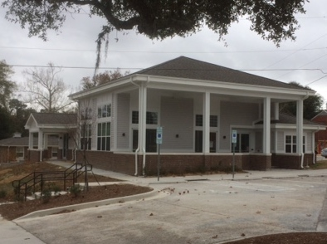
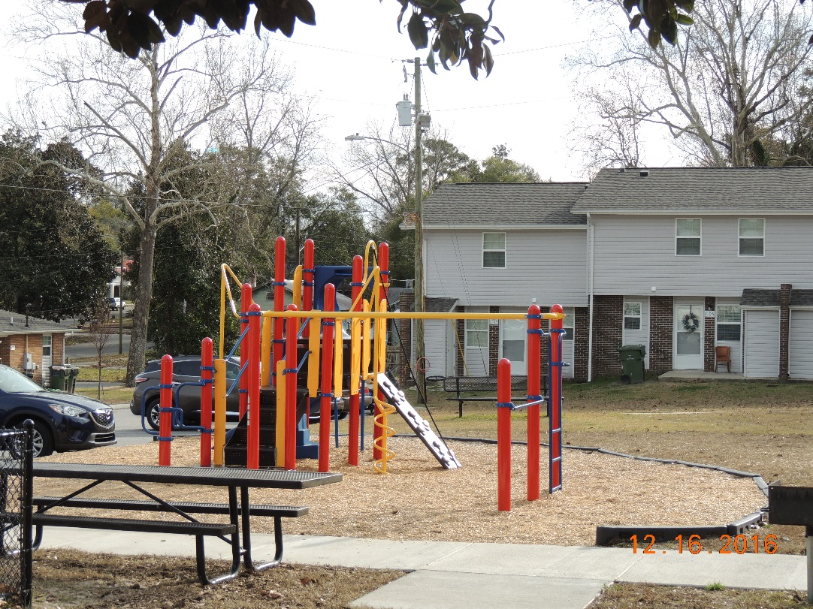
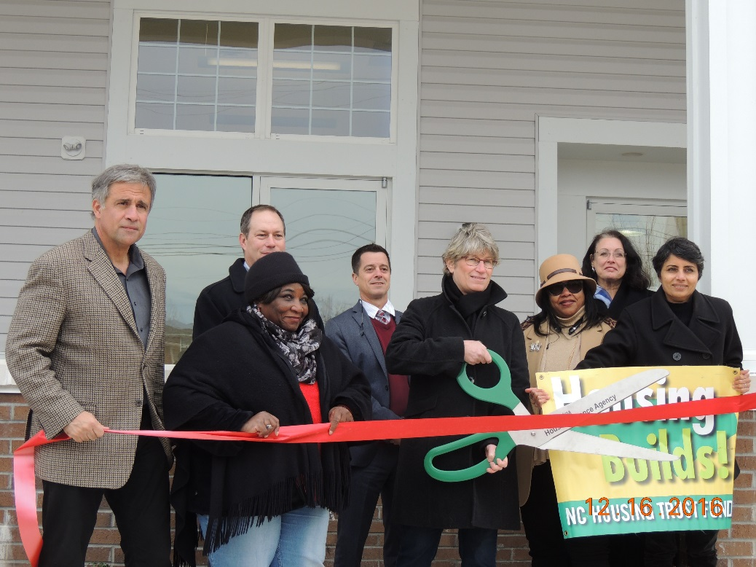
Rankin Place Terrace
Parkside (backyard)

Slide 13
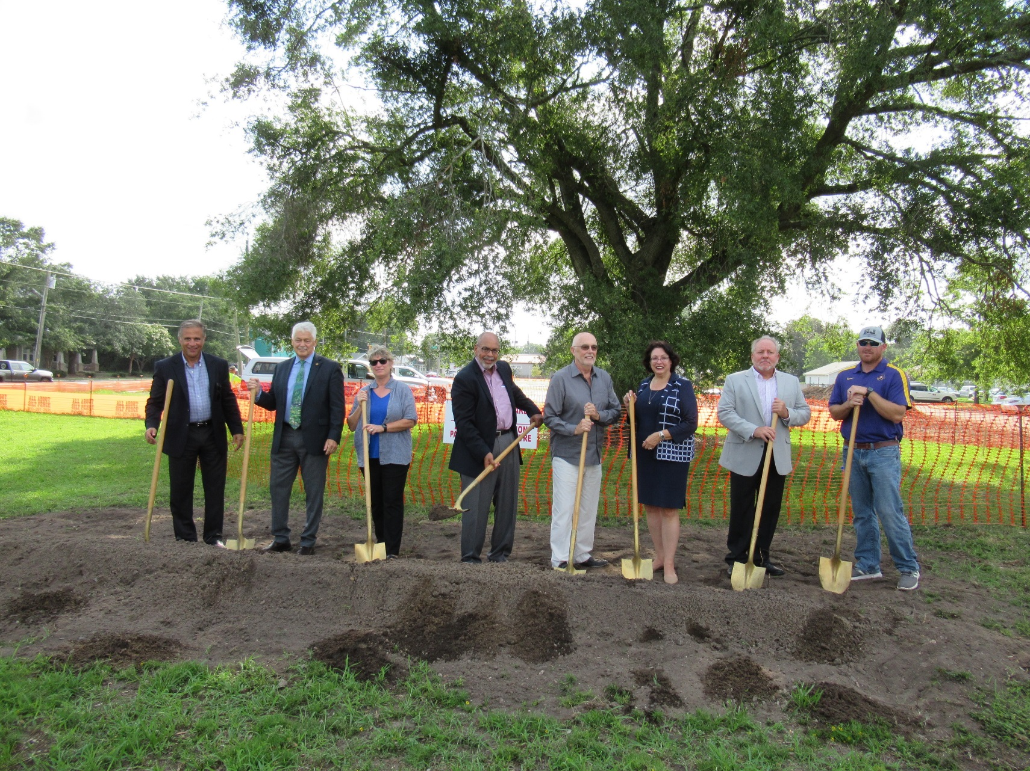
Groundbreaking of Dawson Lofts
Dawson Lofts will be a three-story 24 unit building (one and two-bedrooms) and is the first completely new affordable housing built by the Authority since 2005.

Slide 14
Fayetteville Housing Authority

Slide 15
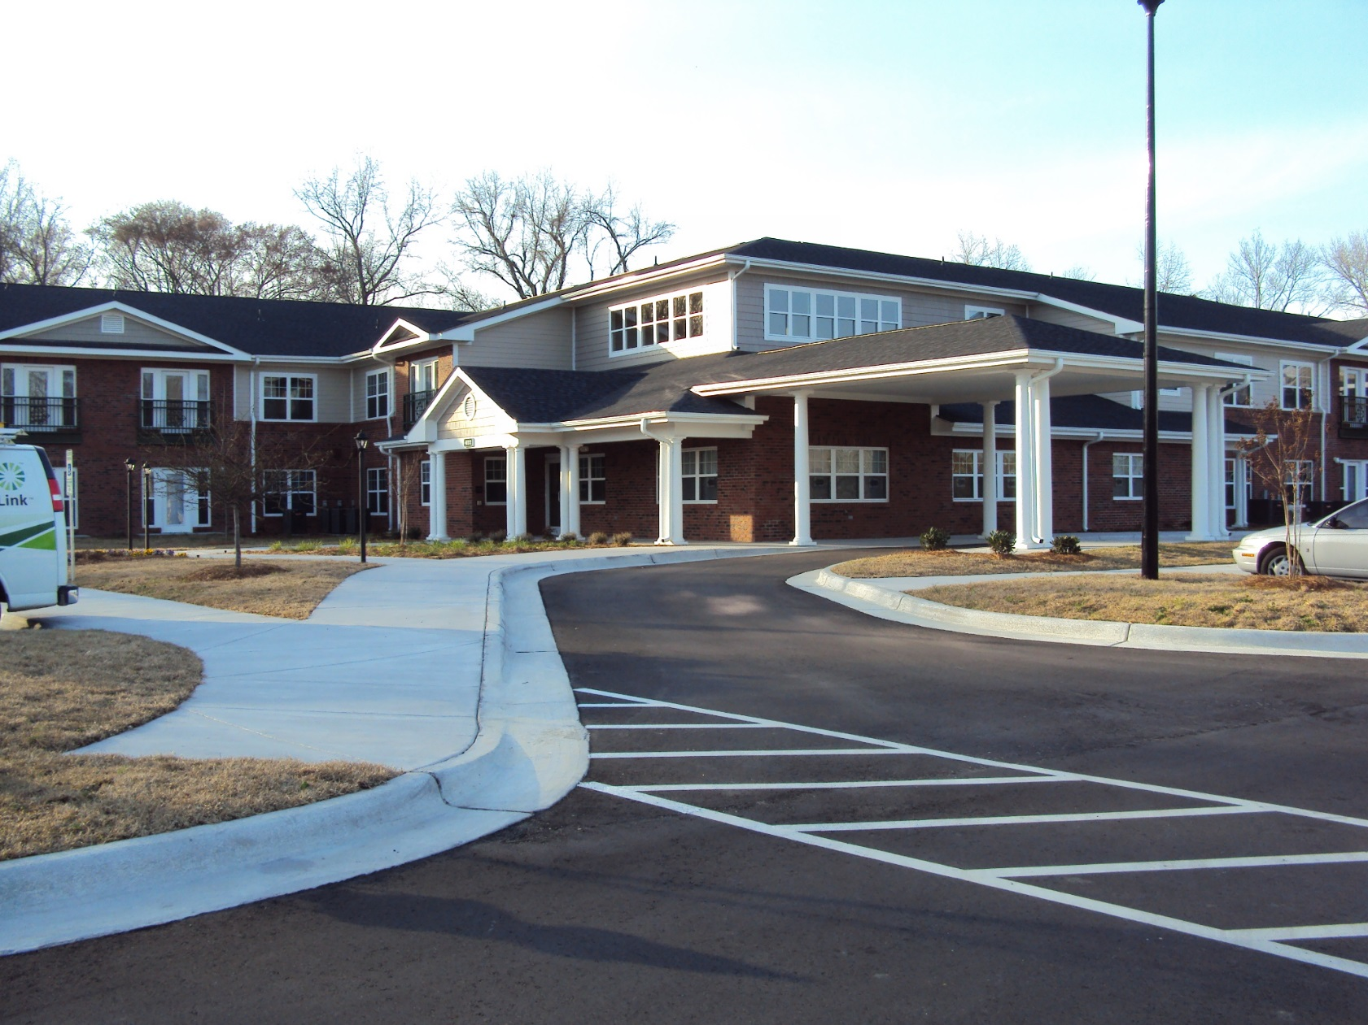
Dogwood Manor

Slide 16
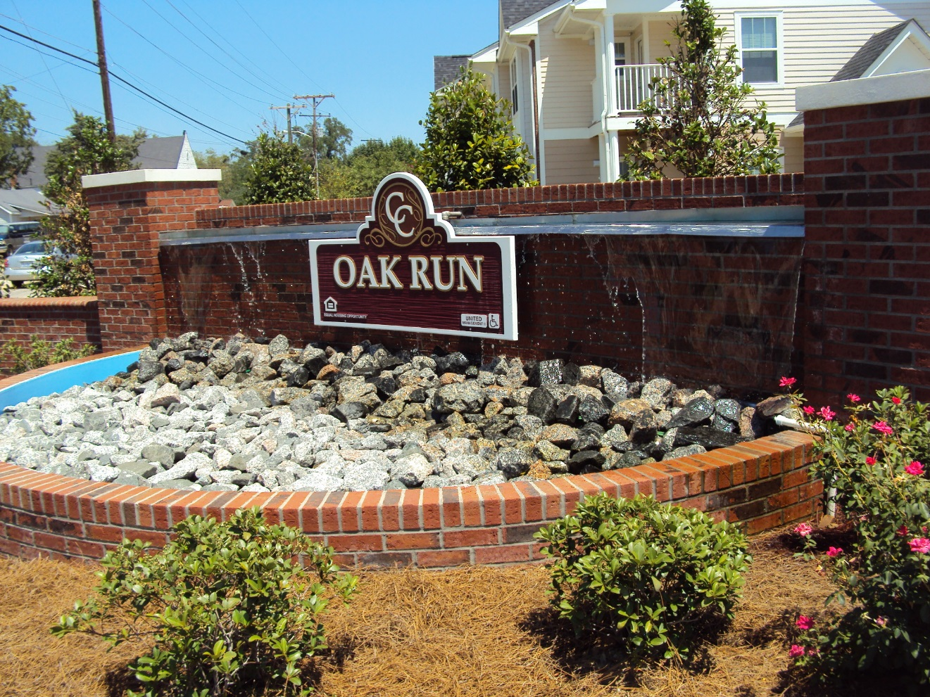
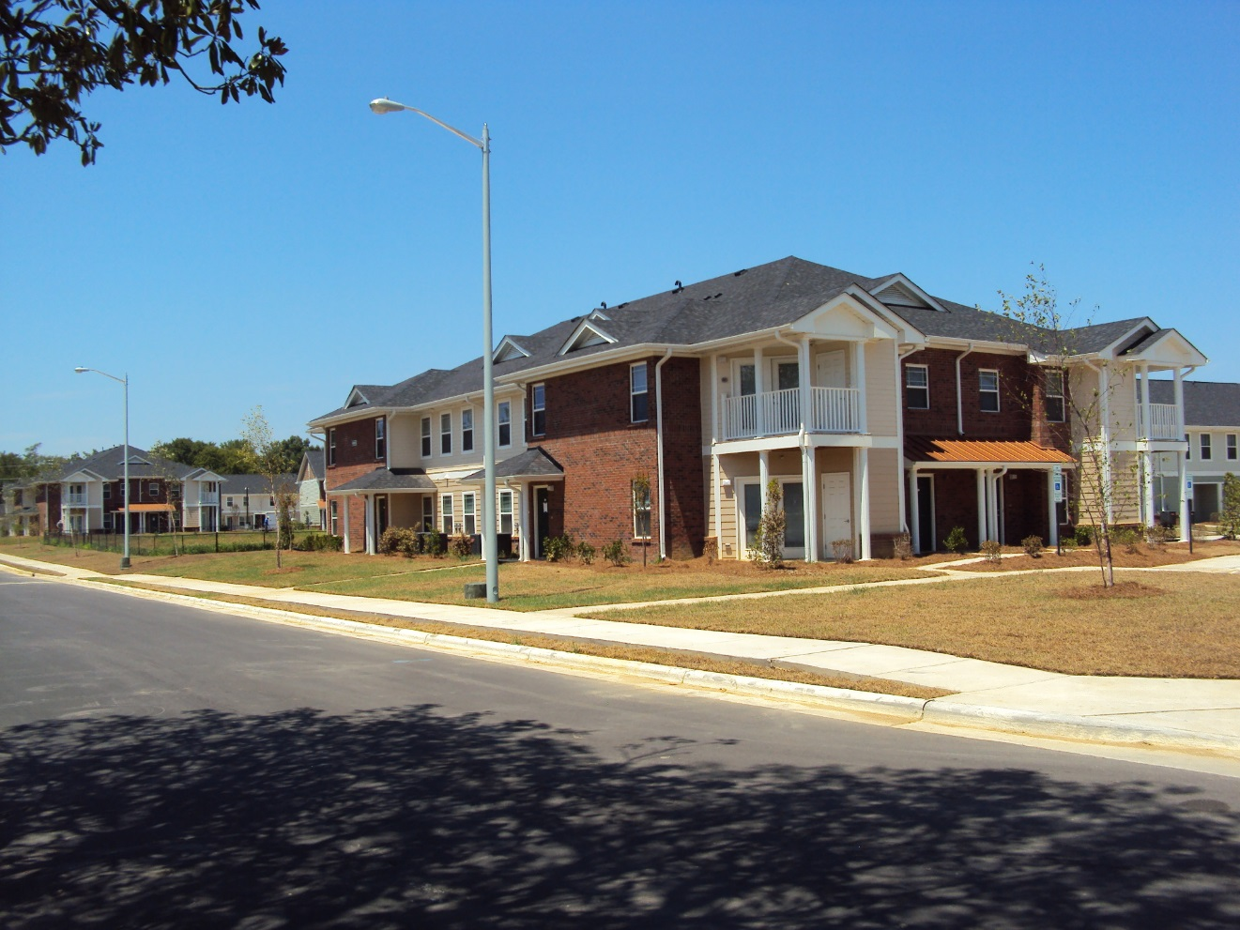
Oak Run

Slide 17
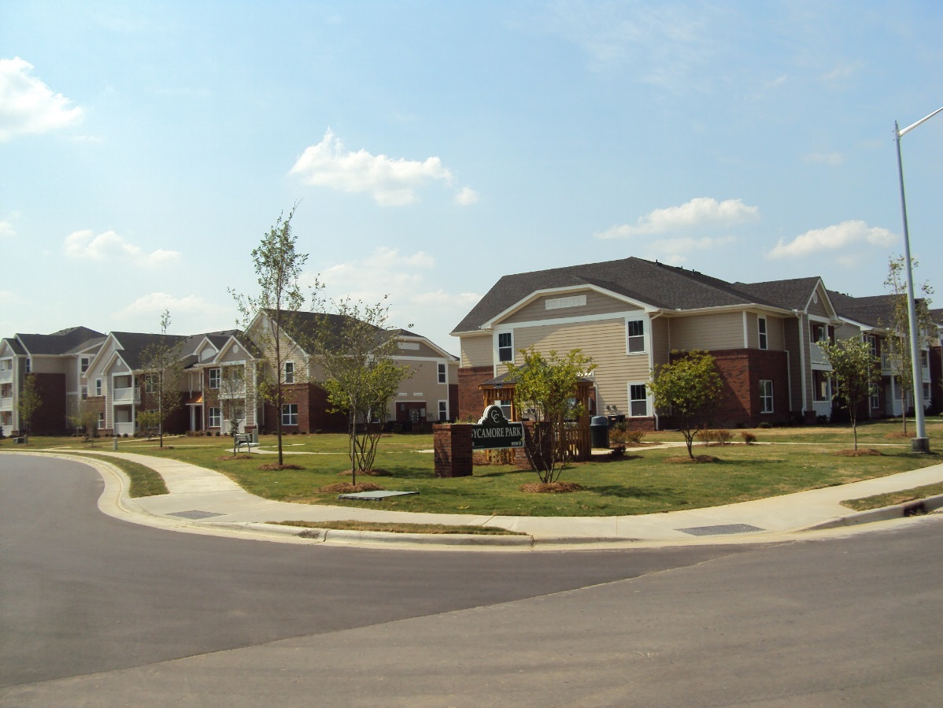
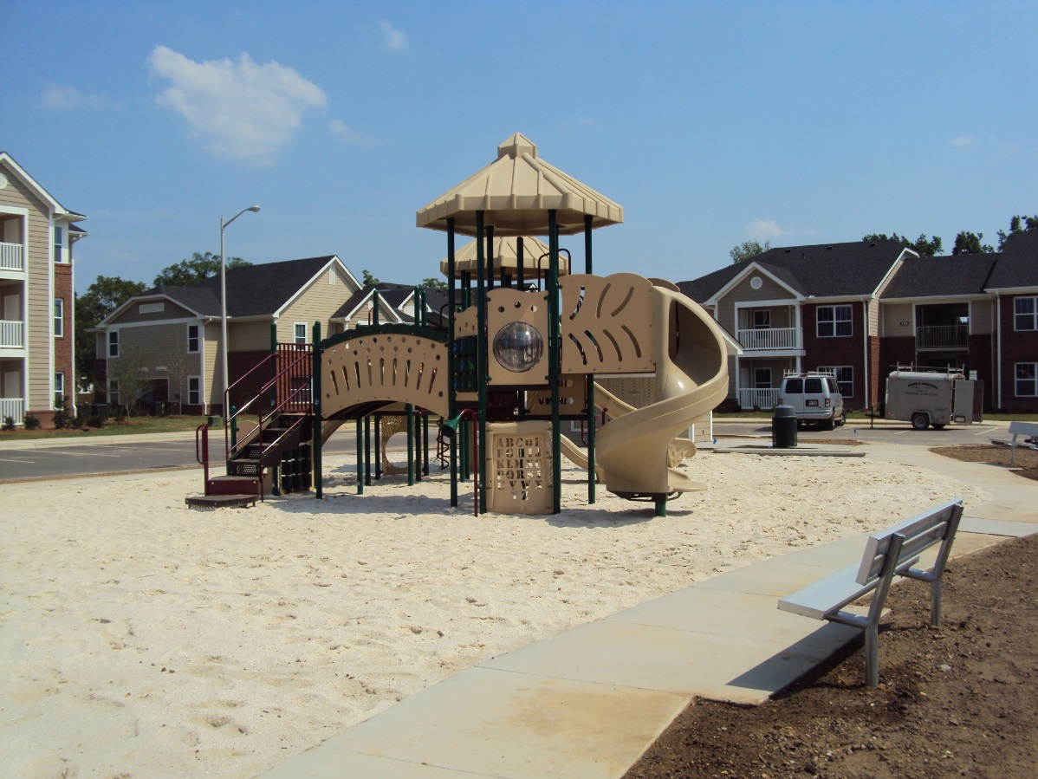
Sycamore Park

Slide 18
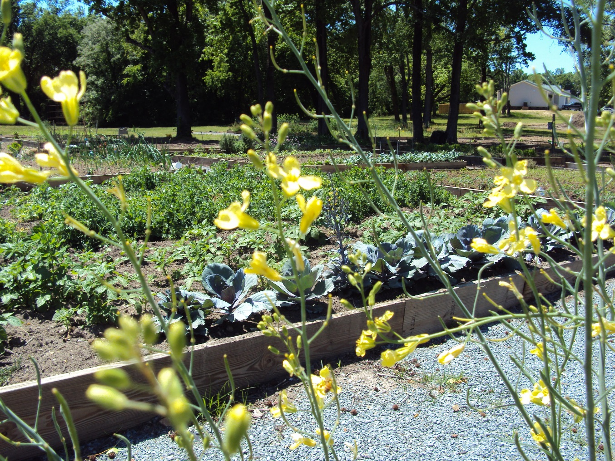
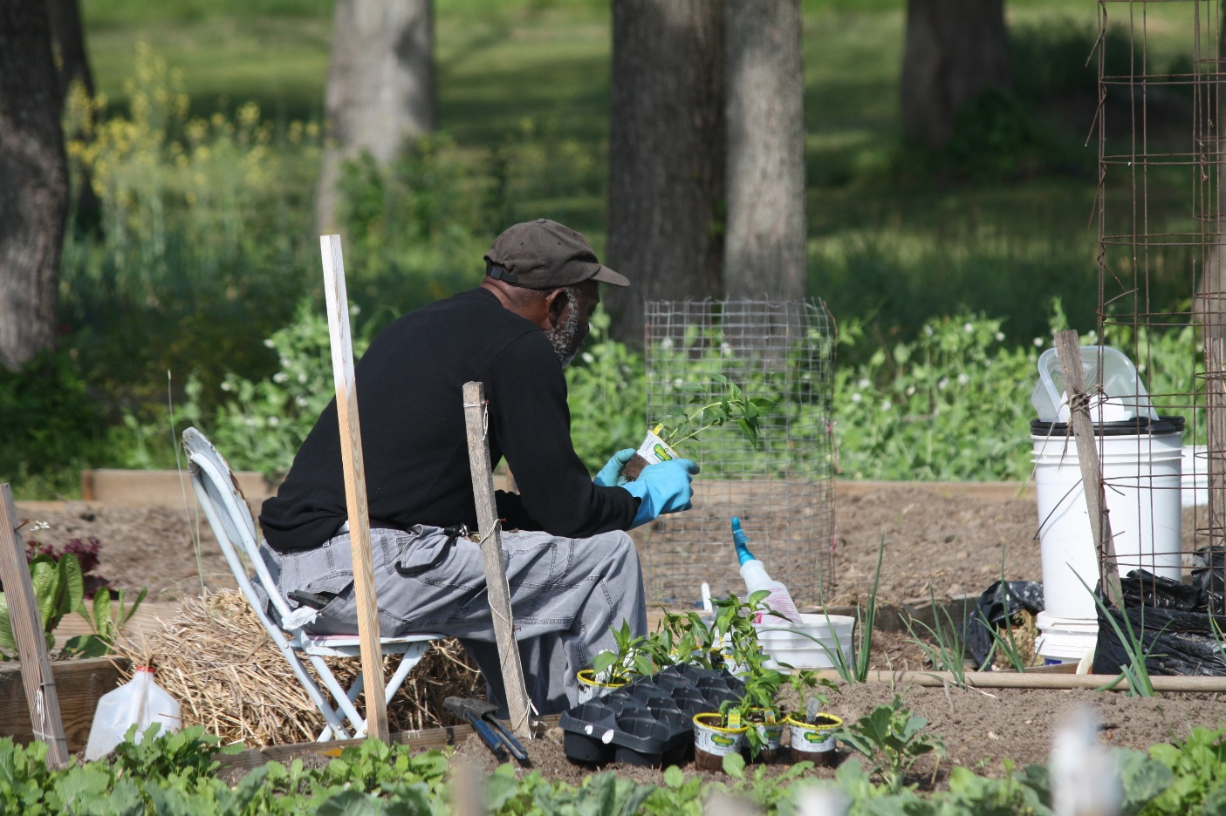
Community Gardens

Slide 19
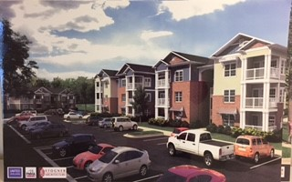
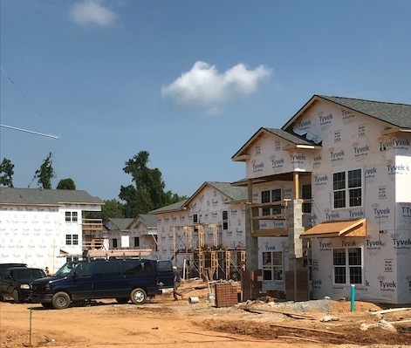
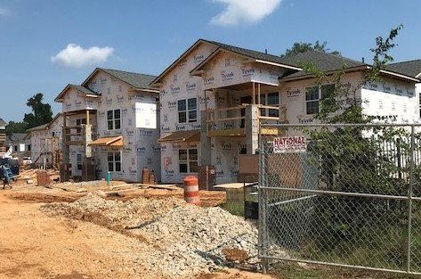
Cross Creek Pointe (new RAD construction)

Slide 20
Goldsboro Housing Authority

Slide 21
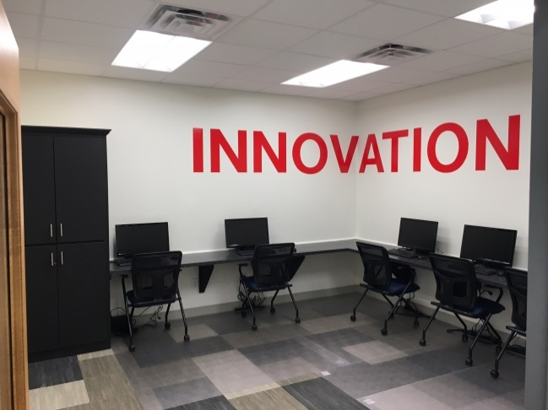
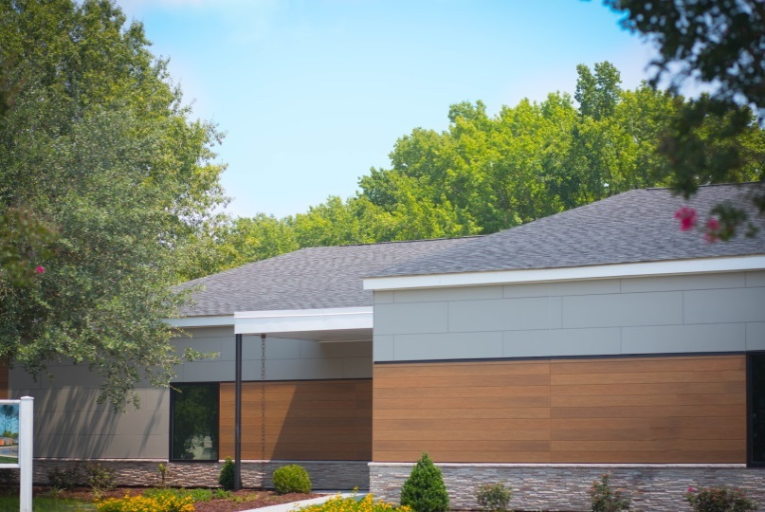
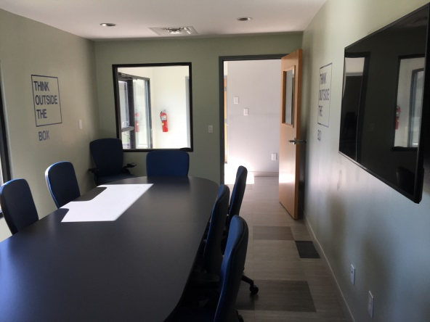
The Dupont Center

Slide 22
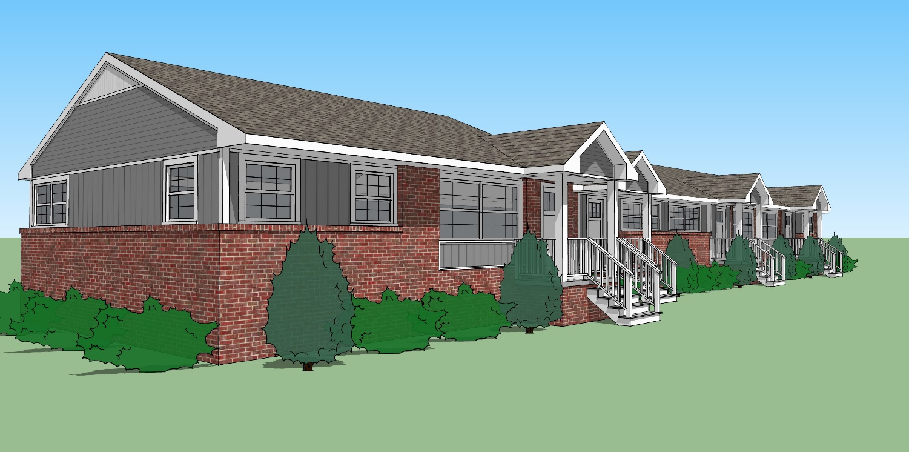
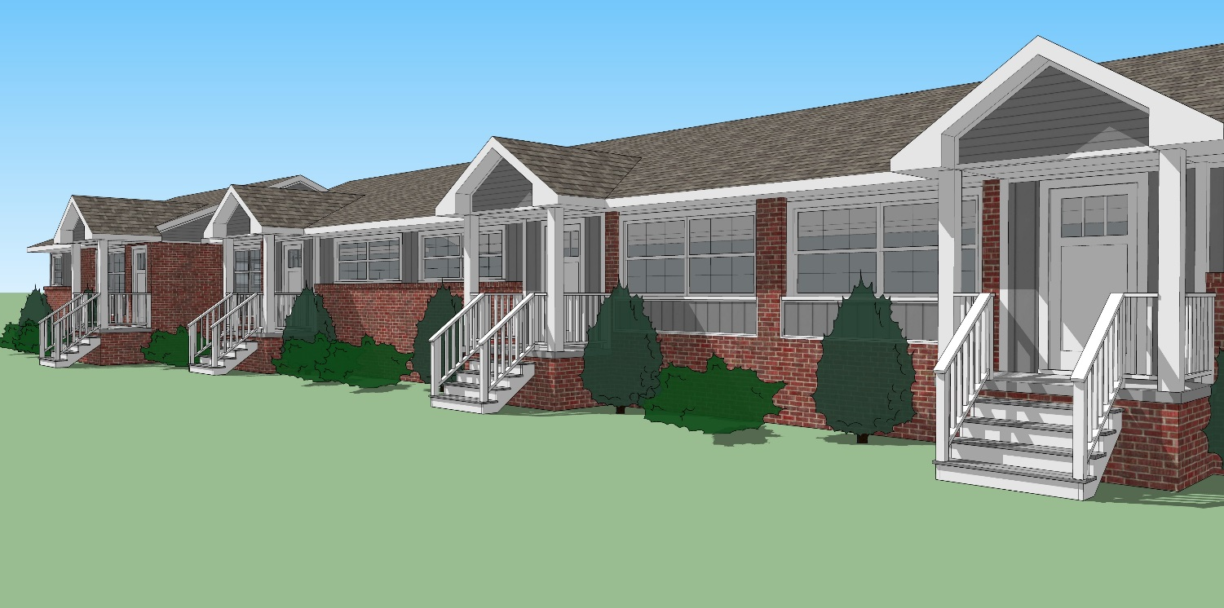
Trinity Court (renovation renderings)

Slide 23
Durham Housing Authority

Slide 24
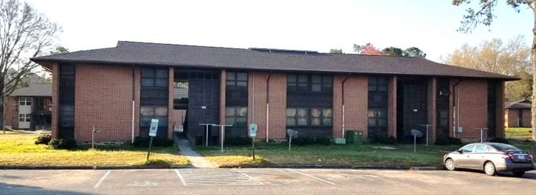
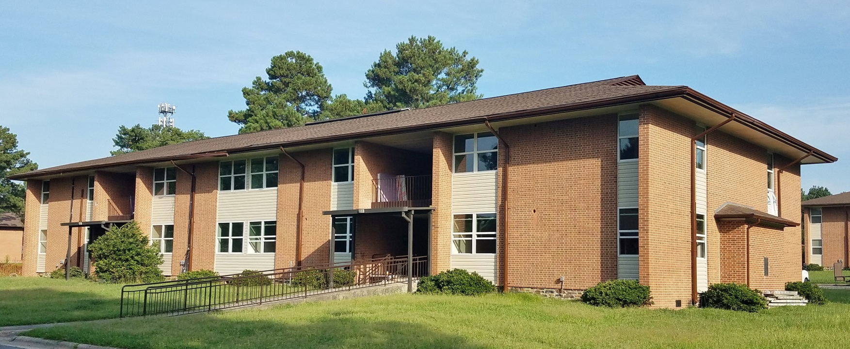
Morreene Road Apartments
Pre Rehab
Morreene Road Apartments
Post Rehab

Slide 25
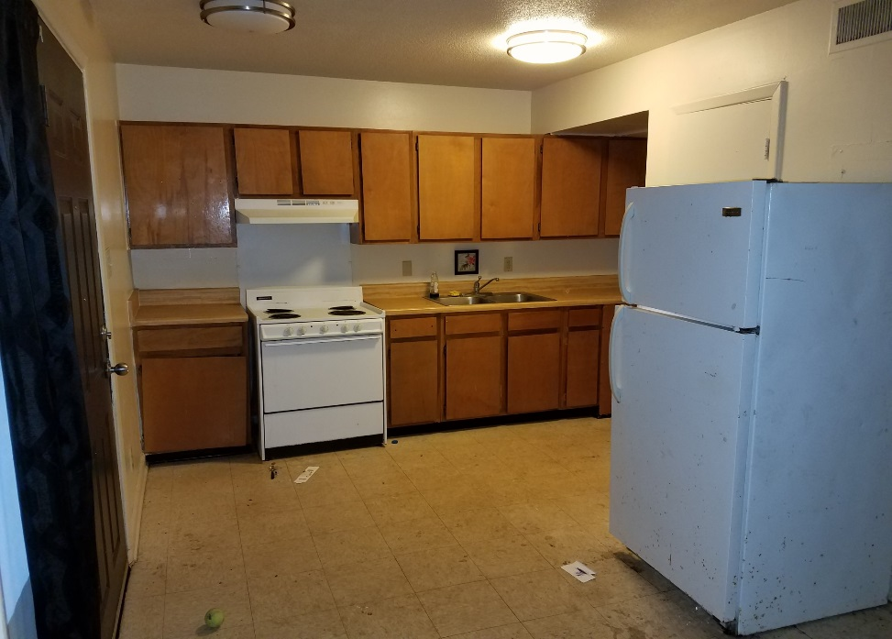
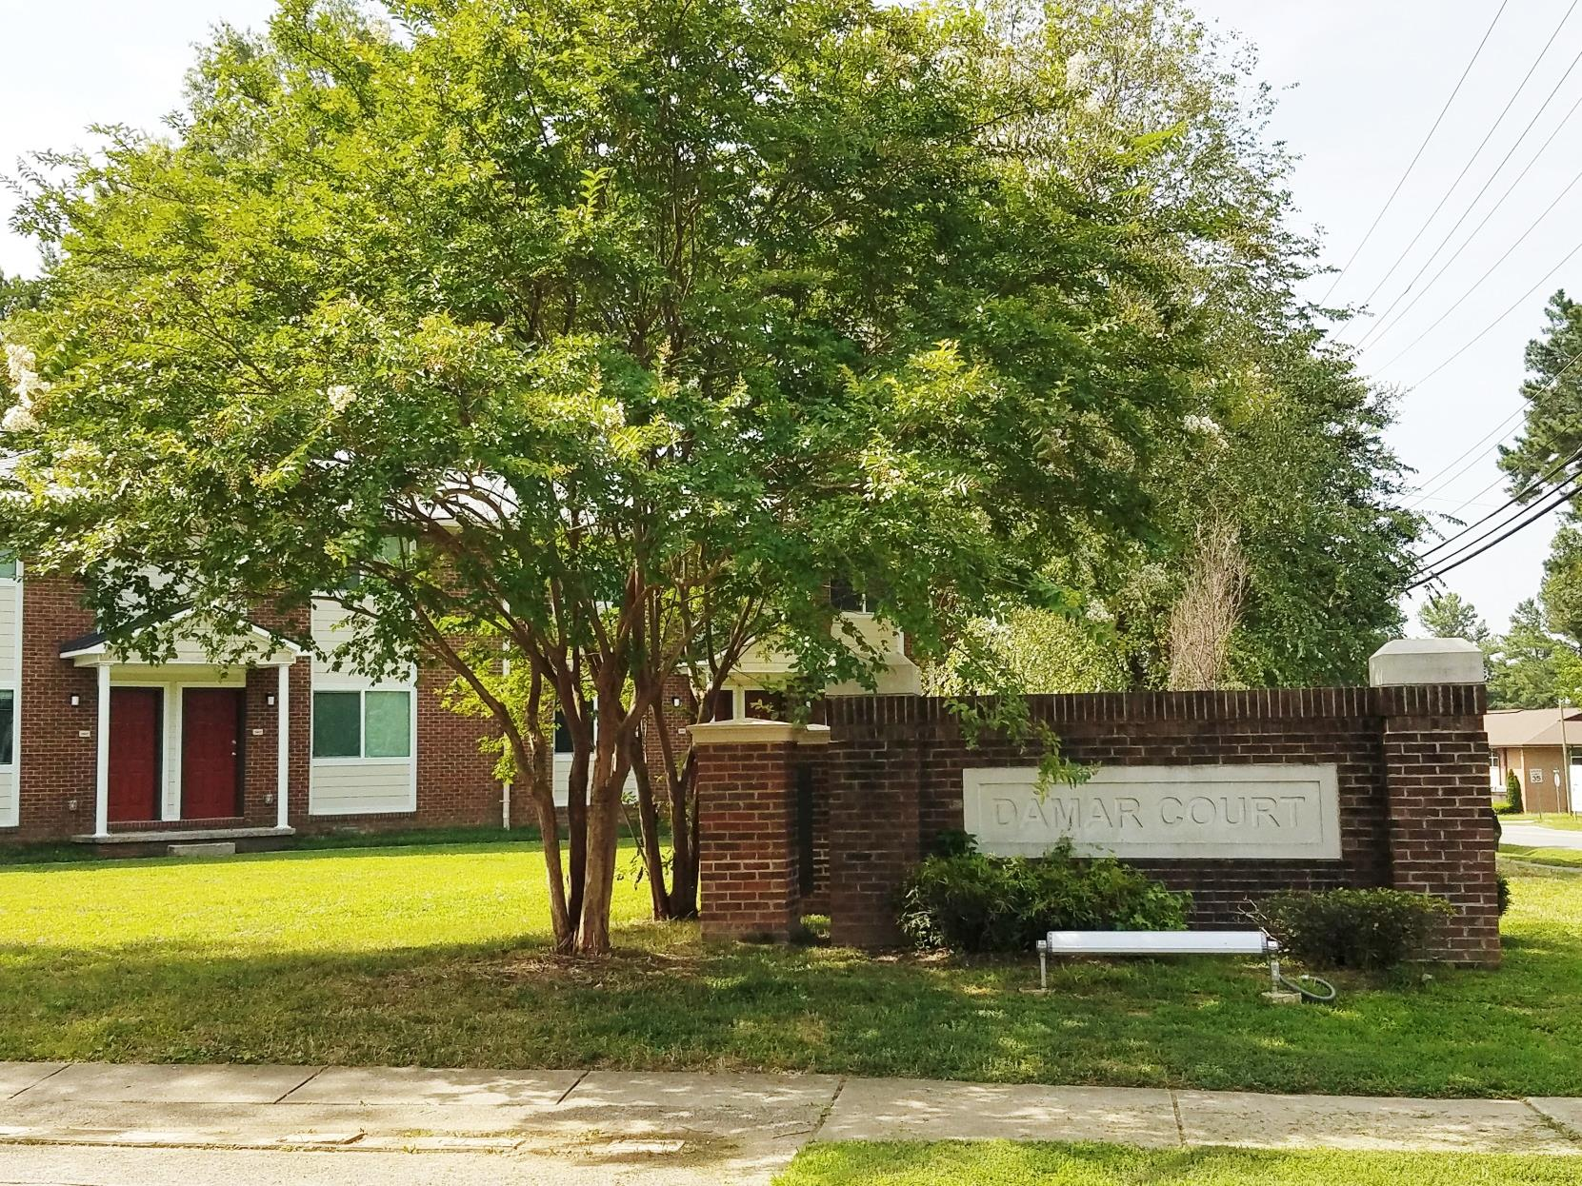
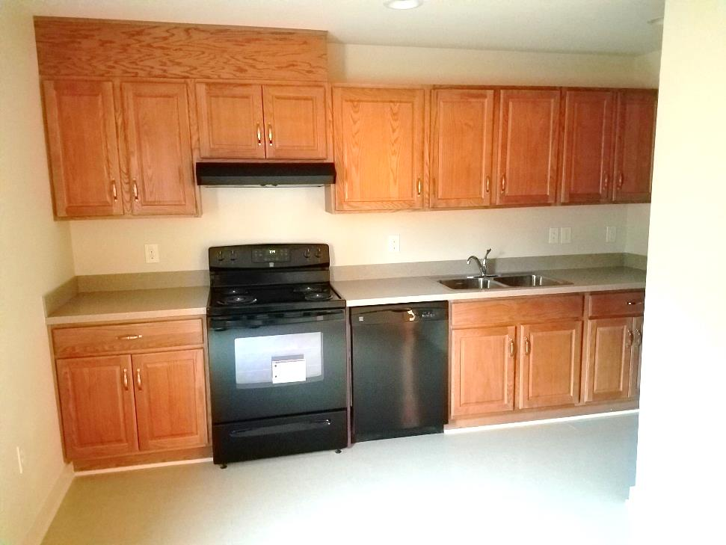
Damar Court
Damar Court
Kitchen Pre Rehab
Damar Court
Kitchen Post Rehab

Slide 26
Charlotte Housing Authority

Slide 27
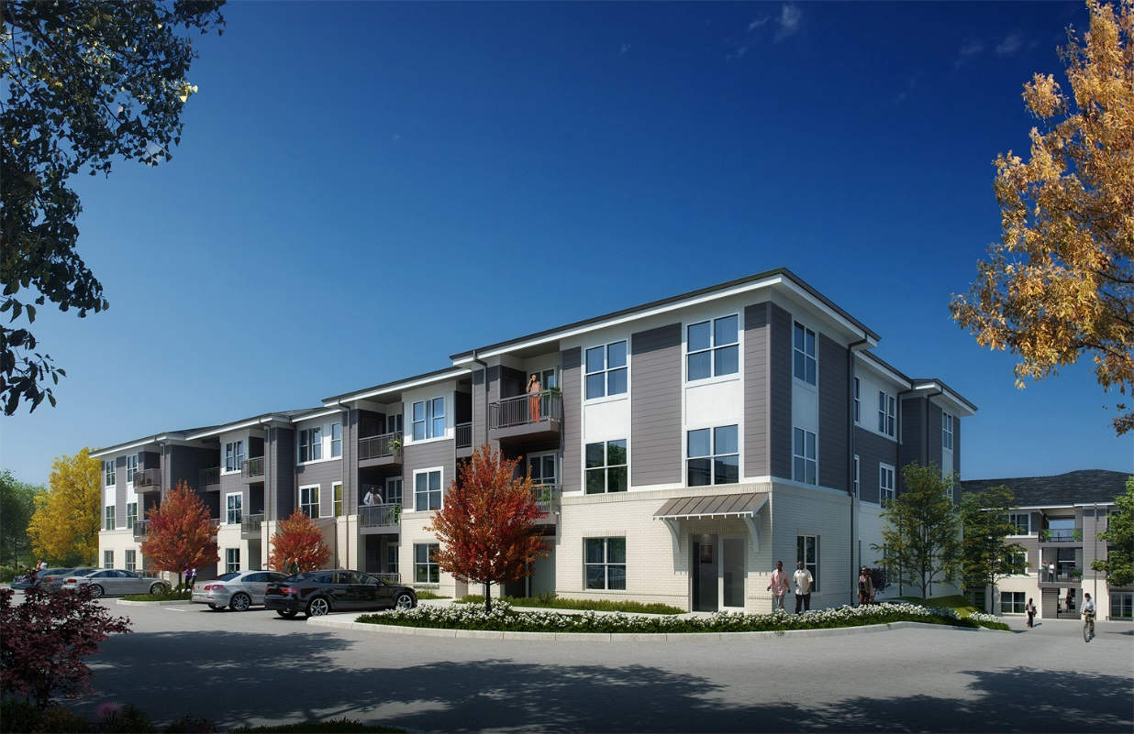
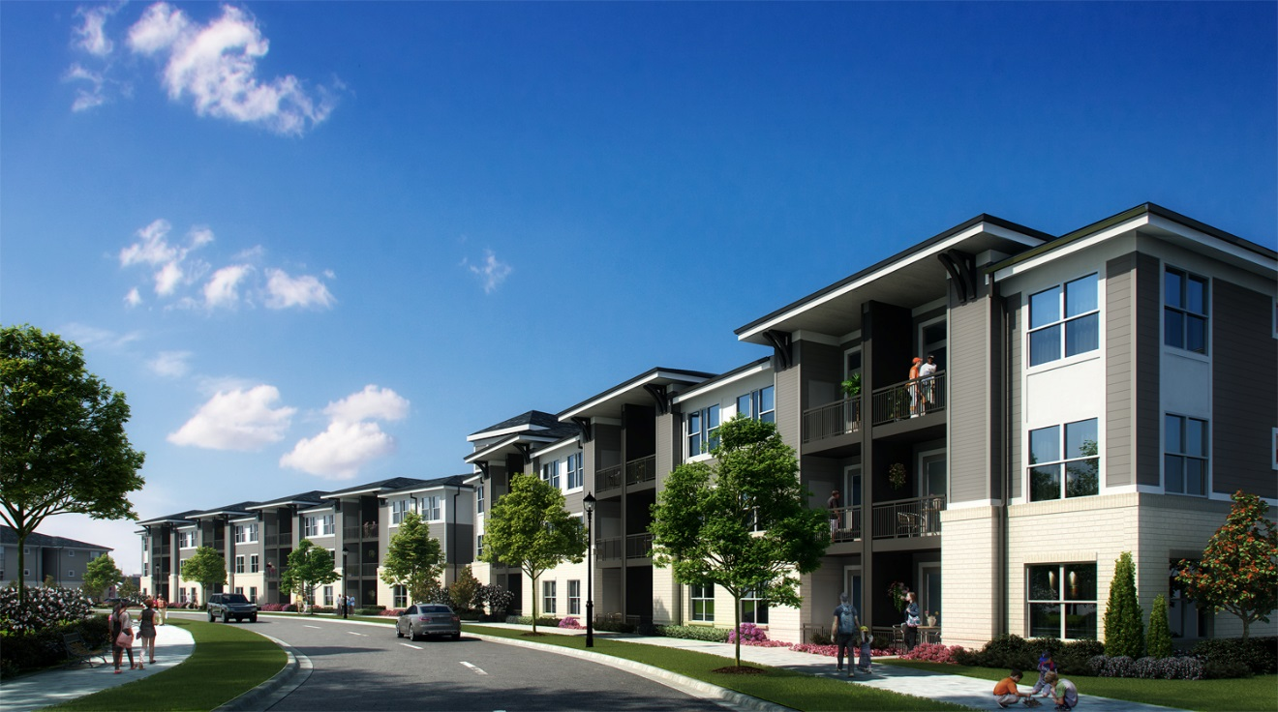
Archdale Families
Archdale Seniors

Slide 28
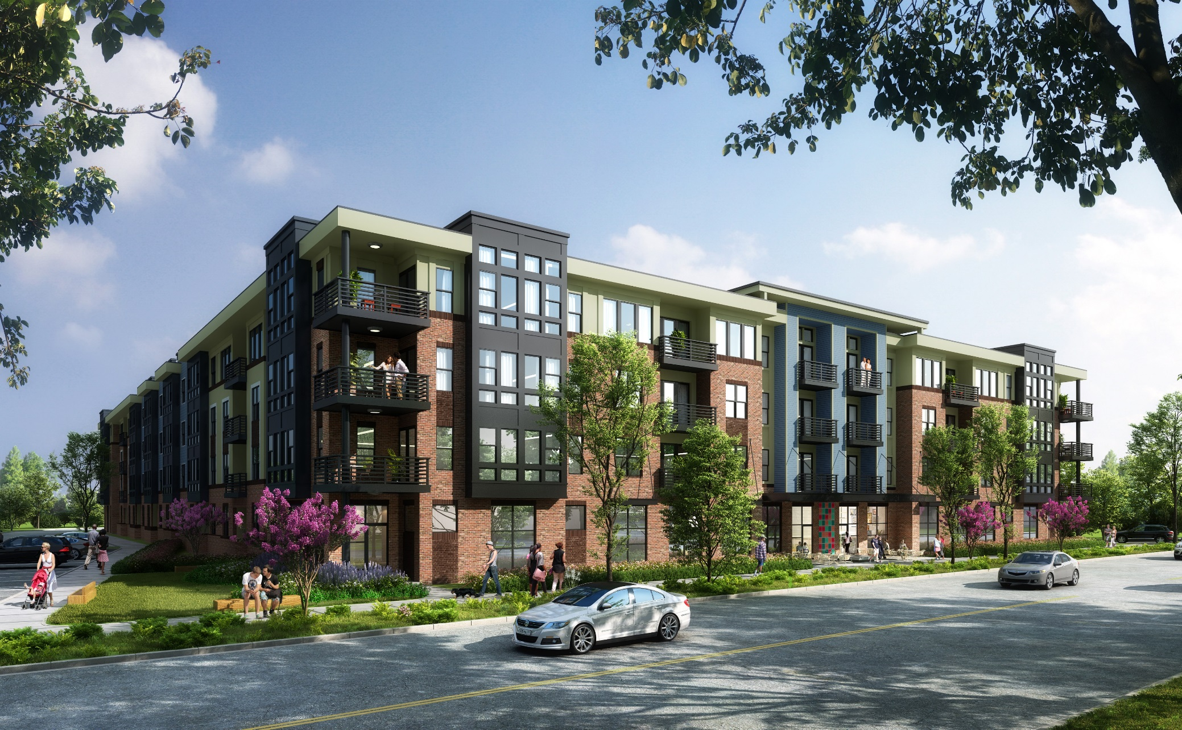
Dillehay (final rendering)

Slide 29
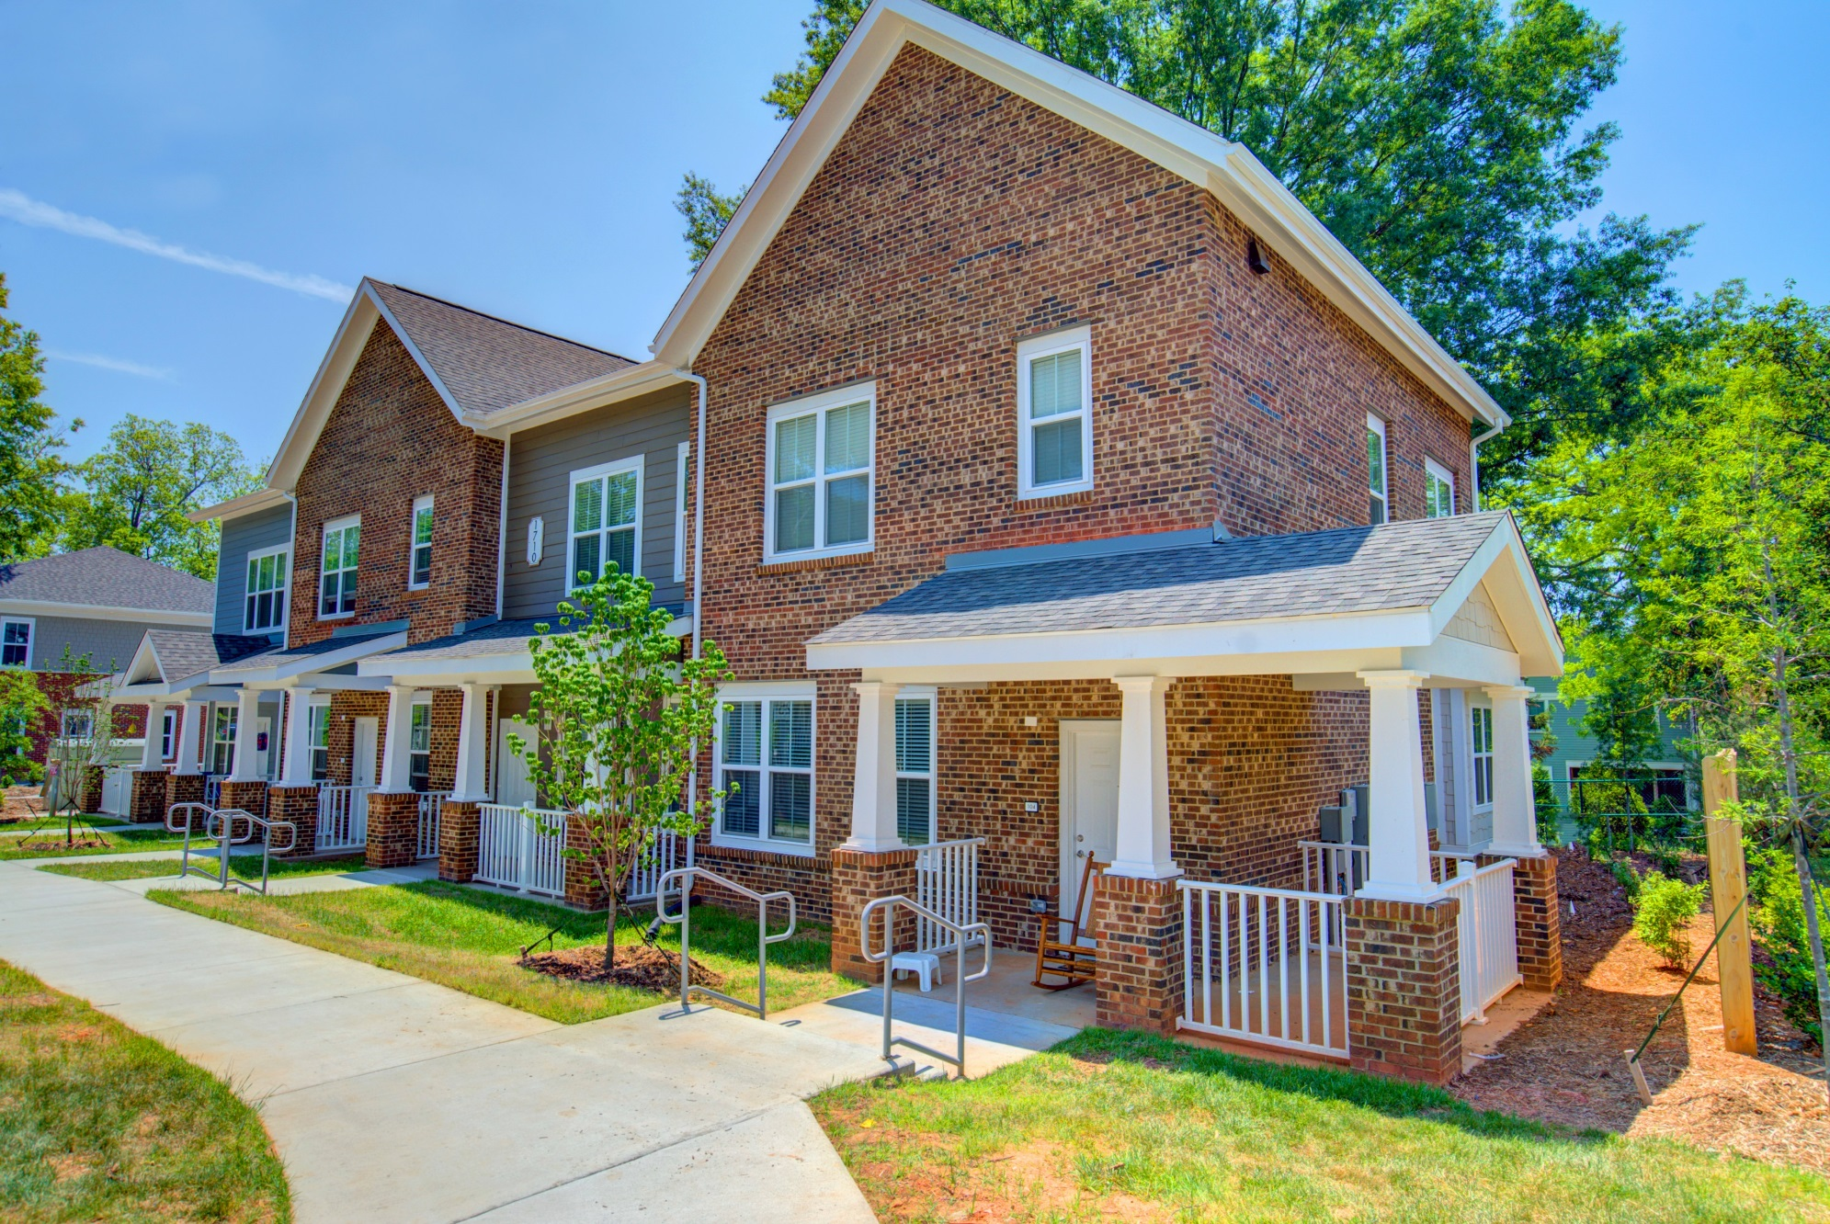
The Oaks at Cherry

Slide 30
R Special Thanks to Our Southeast Regional Convening Local Hosts & Sponsors!

Slide 31
…and our Friends at Dominion Due Diligence Group for producing this show…

Slide 32
Many Thanks to our National Supporters for Helping Make All Our Work Possible!

Slide 33
…and.. ….and…. The Community Builders| Love Funding | Volunteers of America |PMIG Real Estate Advisors | POAH

Slide 34
For the Latest On RAD
radcollaborative.org | info@radcollaborative.org
www.clpha.org/programs/rad
www.hud.gov/RAD

